Slide 1
Zara Fashion Trends Prediction Model
Elsa Figueroa
Gauri Gupta
Miga Budaasuren
Termeh Mohebbie

Slide 2
Table of Content
01
Introduction
04
Model Training
02
Data Transformation
Limitations
05
03
Feature Engineering
06
Conclusion

Slide 3

Introduction and Goal
The main goal of this analysis is to predict the best-performing products for the last week in terms of revenue using the previous week’s data.
This dataset is from a real-world Machine Learning Contest from a major retailer, ZARA, in 2019 with a cash prize.
The data includes 3 months worth of sales, stock, and positioning of items for ZARA online store in a specific country.
Due to business confidentiality, all information is coded.

Slide 4
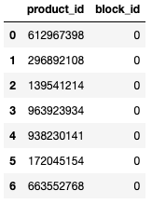
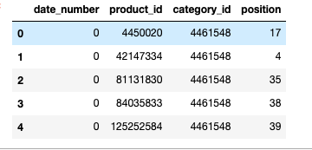
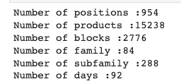
Exploratory Data Analysis
Notes:
any given product have multiple positions
multiple products belong to a certain block
Some stats for the datasets

Slide 5
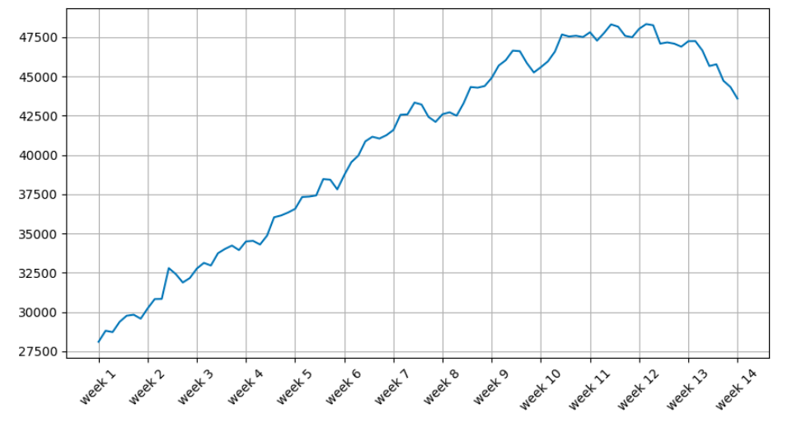
Exploratory Data Analysis
Sales Trend
Notes:
Overall trend in sales is increasing overtime, however, last 3 weeks there is a sudden decrease in the sales.

Slide 6
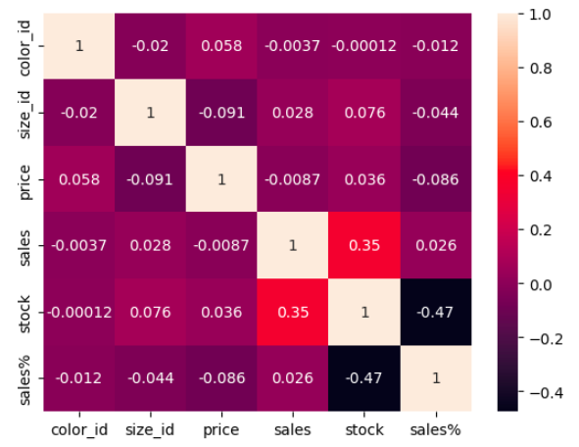
Exploratory Data Analysis
Correlation Map
Strong correlation between sales and stock
No other significant correlation
Notes:
The map shows that there is a strong correlation between sales and stock. There is no other significant correlation is observed.

Slide 7
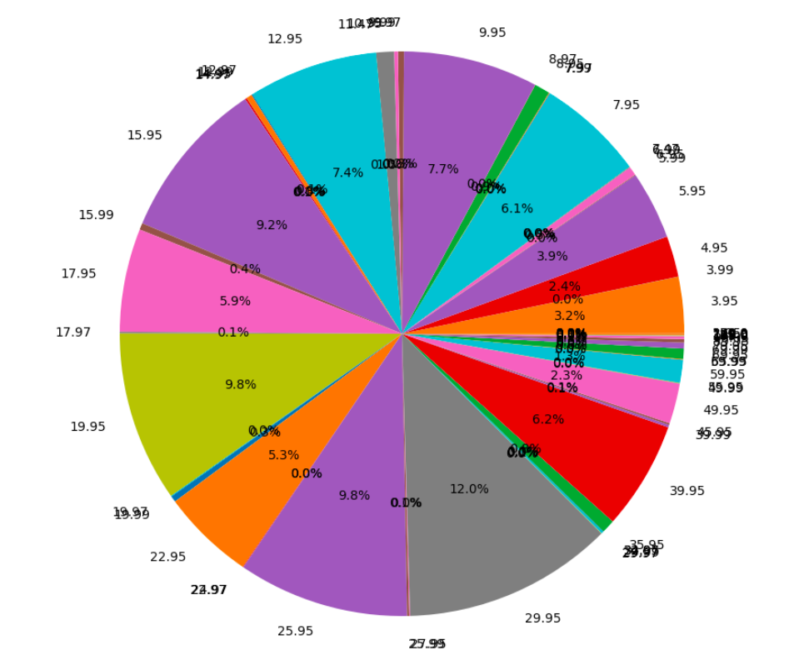
Exploratory Data Analysis
11.99
10.99
Stock Level by Price
13.99
8.97
5.99
We can see the price points for products that have the largest stock are $29.95 and $25.95
19.99
35.95
27.95
Notes:
We can see the price points for products that have largest stock are $29.95 and $25.95.

Slide 8
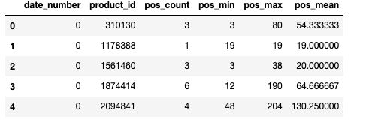
Data Transformation & Feature Engineering
Notes:
EDA shows that any given product have multiple positions. So we decided to aggregate the position . Added the several aggregation results into the original data as additional features.

Slide 9
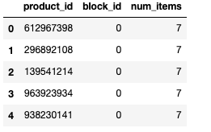
Engineering Engineering
Data Transformation & Feature Engineering continues
Notes:
Similarly, for the block column, EDA shows multiple products belong to a certain block. So again, we decided to aggregate the data and added new columns as num_items (new feature).

Slide 10
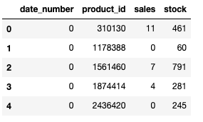
Data Transformation & Feature Engineering continues
As we are interested in product level, we removed the color_id and size_id columns. Then aggregated the sales and stock columns by product only.

Slide 11
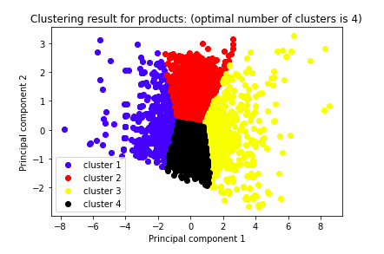
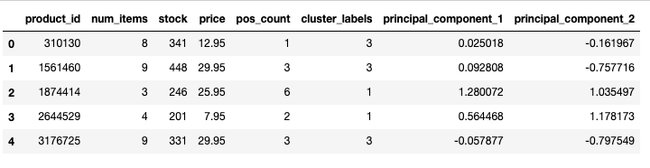
Data Transformation & Feature Engineering continues
Notes:
As the last feature engineering, we chose the last day in the training data ( day 84). Then used unsupervised ML ( to be specific k-means (to find the optimal number of clusters) and PCA (to reduce the dimension and as a result it will give us more clean clusters)) . Plotted the results and added the cluster labels column to the original data as another new feature.

Slide 12
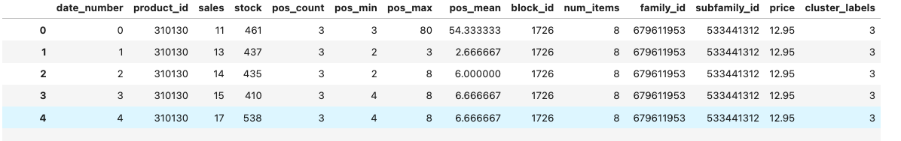
Data Transformation & Feature Engineering continues
Notes:
Merged all 4 transformed data frames into one data frame. Now, the data is ready for model training.

Slide 13
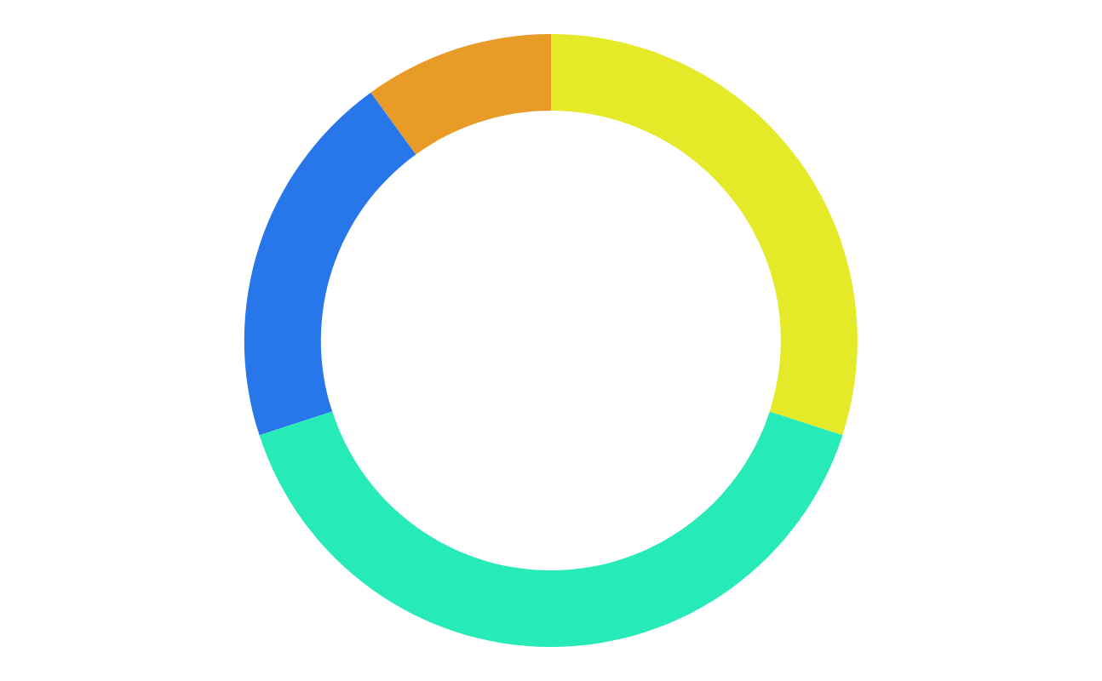
Machine Learning Models
Random forest
Deep Learning
XG Boost
Notes:
-We used 3 different ML models which are RF, XG Boost and DL.
-Classification models such as Logistic Regression would not work in this case since our target variable is numerical.
-Also did not experiment with linear regression because this will go very wrong as we were not able to normalize the categorical variables using dummy variables (0 ,1). The reason is that we have over 15000 products to convert. Even we convert them, still linear regression will suffer from dimensional issue.
-For our project, tree based models work better as they do not depend on data normalization. These models consider each regressor independently unlike linear regression which regressors will have interdependency with each other where data normalization is necessary.

Slide 14
Experiment Results
 | R score
Random Forest n_estimators=100, random_state=42 | 0.40
XGBoost experiment 1: n_estimators=100, max_depth=7 | 0.50
XGBoost experiment 2: n_estimators=200, max_depth=10 | 0.59
XGBoost experiment 3: n_estimators=300, max_depth=10 | 0.60
XGBoost with fewer features experiment 4: n_estimators=300, max_depth=10 | 0.61
Deep learning -2 hidden layers and a total of 50 nodes, 1 output layer -Activation='relu’ , loss='mse', optimizer='rmsprop’, epoch =10 | -3.340532347850811e-06

Slide 15
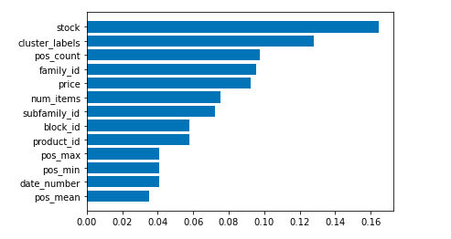
The Feature Importance of the XG Boost 3rd Experiment

Slide 16
Accuracy for top 100 products (by revenue) predicted vs actual
Day | Accurately Predicted Percentage
85 | 66%
86 | 61%
87 | 50%
88 | 49%
89 | 45%
90 | 45%
91 | 51%

Slide 17
Limitations
01 | R score is 0.61 and there is a room to improve
02 | Did not include color and size features which might have an impact on the model performance
03 | Data confidentiality limitation ( did not provide useful insights to use in a real business world)
04 | Only 3 months data

Slide 18
Conclusion
01 | EDA : EDA showed us the complexity of the data. More specifically, the sudden change in the trend and scale of features, etc. This makes the model prediction more difficult.
02 | Feature Engineering : Added new features like cluster labels (2nd), position count (3rd), number of items (5th) were shown as very important features. (Total 13 features)
03 | Model Training : XGBoost provided the best performing model and Deep Learning model was the worst performing model. Random Forest was the medium performing one. Logistic Regression and linear regression will not work for our case.
04 | Prediction : About Top 100 best performing products, we predicted 50-60% accurately. The further forecasting horizon, the lower the accuracy.

